Slide 1
Ration Balancing
Team Name: Nightmare
Abhiram Madugula
Haritha Atmkuri
Akhila Gandra
Suresh Chandra Peddinti
Razeena Rao Nemarugommula
Divyaharshini Bheemireddy

Slide 2





Client Dr. Marcus McGee

Slide 3
Roles of Team Members
Abhiram Madugula (Developer, Tester)
Haritha Atmakuri ( Developer)
Suresh Chandra Peddinti (Developer )
Razeena Rao Nemarugommula (Developer, Team Lead)
Divyaharshini Bheemireddy (Developer, Tester)
Akhila Gandra (Developer, Tester)

Slide 4


Problem Statement
In order to feed cattle with proper amount and proportions of nutrients needed for an animal per day in minimal price with the given food ration.

Slide 5
USER REQUIREMENTS
User must select the weight of cattle and growth requirements of different categories of dairy animals.
Default nutrient range is displayed based on selected cattle weight and its growth requirement.
The user should be able to edit the nutrient range if needed.
User should select the ingredients required to feed the cattle.

Slide 6
Cont.…
User should enter the ingredient percentage and cost of the ingredient.
The app should give the optimal solution which gives each ingredient weight based on the cost.
User should create a new ingredient with Admin login.

Slide 7

Problem solving approach
We have developed an iOS application.
The user can use this application in an iPad.
We constantly communicated with the client about the project and made decisions effectively as a team.

Slide 8
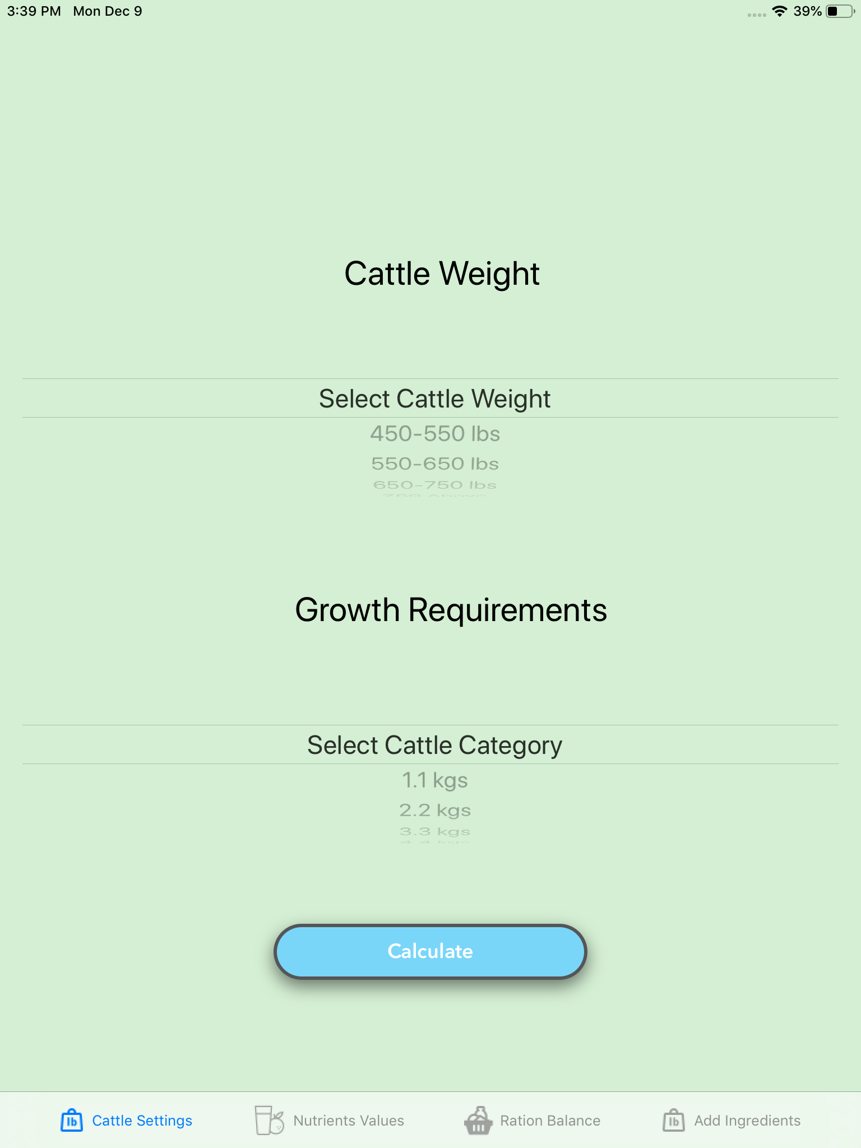
Demo
Enjoy the demo.

Slide 9


Slide 10


